Slide 1
FLOW CHART SYMBOL
START the program
INPUT a value
OUTPUT on console
DECIDE something
PROCESS something
STOP the program

Slide 2
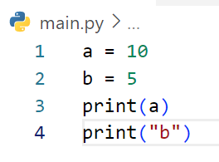
DRAW FLOWCHART
START
a = 10
b = 5
EXAMPLE
Print a
Print “b”
END

Slide 3
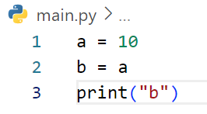
DRAW FLOWCHART
START
a = 10
b = a
Print(“b”)
END

Slide 4
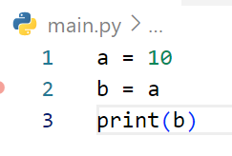
DRAW FLOWCHART
START
a = 10
b = a
Print(b)
END

Slide 5
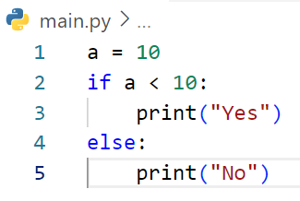
START
DRAW FLOWCHART
EXAMPLE
a = 10
No
a < 10?
Yes
Print “Yes”
Print “No”
END

Slide 6
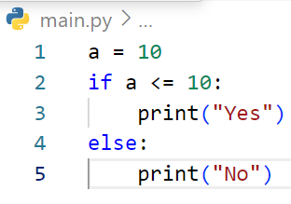
START
DRAW FLOWCHART
a = 10
No
a <= 10?
Yes
Print “Yes”
Print “No”
END

Slide 7
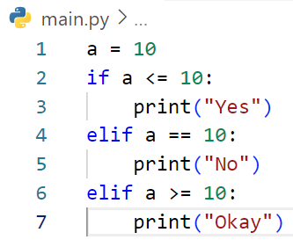
START
DRAW FLOWCHART
EXAMPLE
a = 10
No
a < 10?
a == 10?
No
Yes
Print “Yes”
Yes
a >= 10?
No
Print “No”
Yes
Print “Okay”
END

Slide 8
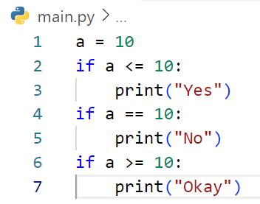
START
DRAW FLOWCHART
a = 10
No
a <= 10?
a == 10?
No
Yes
Print “Yes”
Yes
a >= 10?
No
Print “No”
Yes
Print “Okay”
END

Slide 9
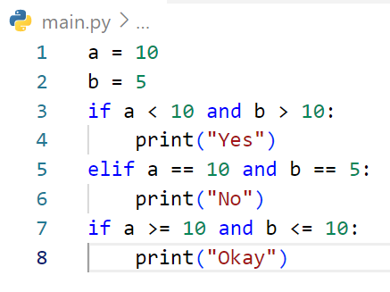
START
DRAW FLOWCHART
a = 10
a = 5
a < 10
and
b > 10?
No
Yes
a == 10
And
b==5?
No
Print “Yes”
Yes
a >= 10
and
b<= 10?
No
Print “No”
Yes
Print “Okay”
END

Slide 10
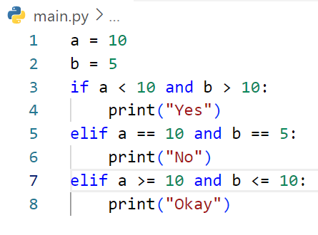
START
DRAW FLOWCHART
a = 10
a = 5
No
a < 10 and b>10
?
a == 10?
No
a == 10 and b==5
?
Yes
Print “Yes”
No
Yes
a >= 10 and b <= 10
?
Print “No”
Yes
Print “Okay”
END

Slide 11
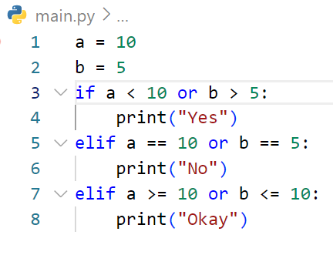
START
DRAW FLOWCHART
a = 10
a = 5
No
a < 10 or b>5
?
a == 10 or b==5
?
No
Yes
Print “Yes”
Yes
a >= 10 or b <= 10
?
No
Print “No”
Yes
Print “Okay”
END

Slide 12
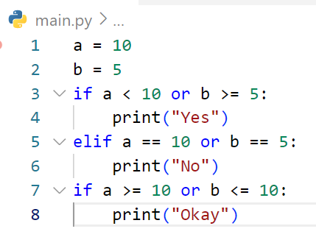
START
DRAW FLOWCHART
a = 10
a = 5
a < 10
or
b > =5?
No
Yes
a == 10
or
b==5?
No
Print “Yes”
Yes
a >= 10
or
b<= 10?
No
Print “No”
Yes
Print “Okay”
END

Slide 13
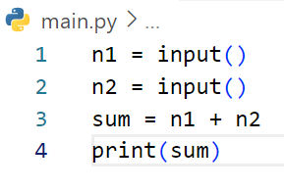
START
DRAW FLOWCHART
Get n1
Get n2
# If user enter first : 3 and second 5
sum = n1 + n2
EXAMPLE
Print sum
END

Slide 14
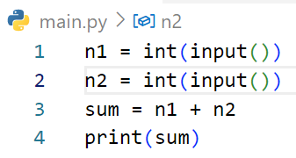
DRAW FLOWCHART
START
Get n1
3
# If user enter first : 3 and second 5
Get n2
5
sum = n1 + n2
Print sum
END

Slide 15
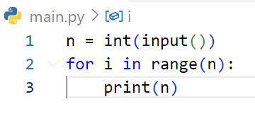
START
DRAW FLOWCHART
Get n
3
EXAMPLE
# If user enter : 3
Done
REPEAT n TIMES
Ongoing
Print n
END

Slide 16
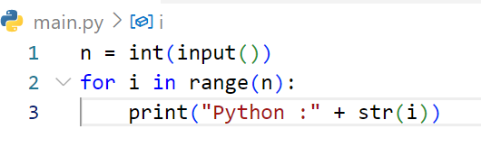
START
DRAW FLOWCHART
Get n
3
# If user enter : 3
Done
REPEAT n TIMES
Ongoing
Print “Python :” + str (i)
END

Slide 17
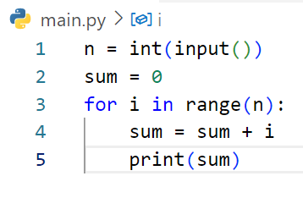
START
DRAW FLOWCHART
Get n
3
# If user enter : 3
Done
REPEAT n TIMES
Ongoing
Sum = sum + i
Ongoing
Print sum
END

Slide 18
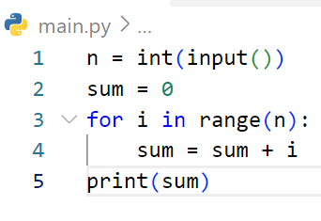
START
DRAW FLOWCHART
Get n
2
sum = o
# If user enter : 2
Done
REPEAT n TIMES
Ongoing
sum = sum + i
Print sum
START

Slide 19
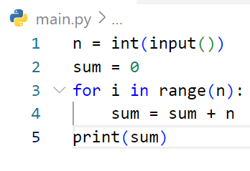
START
DRAW FLOWCHART
Get n
4
sum = 0
# If user enter : 4
Done
REPEAT n TIMES
Ongoing
sum = sum + n
Print sum
END

Slide 20
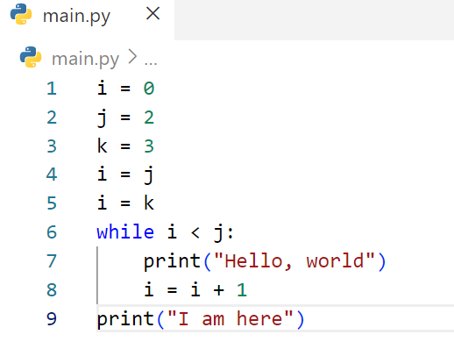
START
DRAW FLOWCHART
i = 0
j = 2
k = 3
i = j
i = k
no
i < j ?
yes
Print”Hello, world”
i = i + 1
Print”I am here”
END

Slide 21
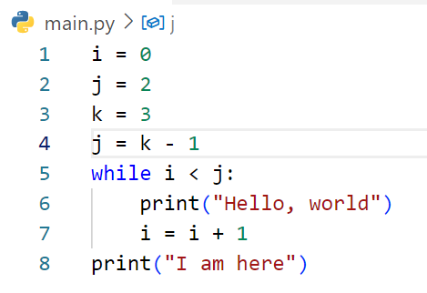
START
DRAW FLOWCHART
i = 0
j = 2
k = 3
J = k - 1
no
i < j ?
yes
Print”Hello, world”
i = i + 1
Print”I am here”
END

Slide 22
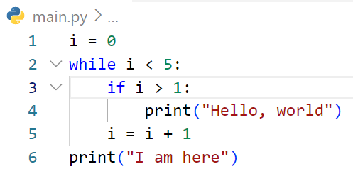
START
DRAW FLOWCHART
i = 0
no
i < 5 ?
yes
i > 1 ?
no
yes
Print “Hello, world”
i = i + 1
Print “I am here”
END

Slide 23
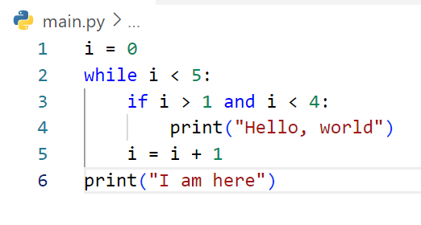
START
i = 0
DRAW FLOWCHART
no
i < 5 ?
yes
no
i > 1 and i < 4 ?
yes
Print “Hello, world”
i = i + 1
Print “I am here”
END

Slide 24
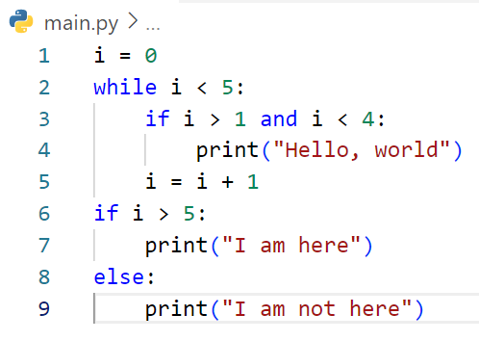
START
DRAW FLOWCHART
i = 0
no
i < 5 ?
yes
no
i > 1 and i < 4 ?
yes
Print “Hello, world”
i = i + 1
i < 5 ?
no
yes
Print “I am here”
Print “I am here”
END

Slide 25
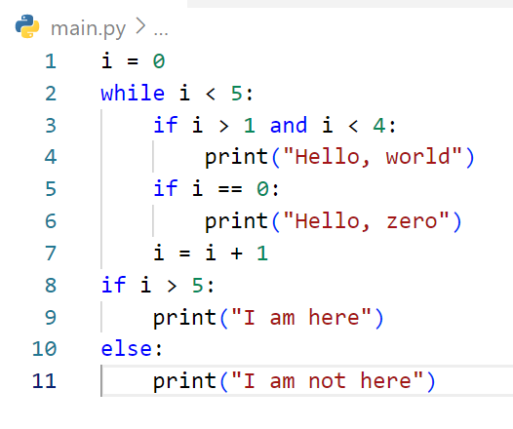
START
DRAW FLOWCHART
i<5
yes
no
i<1 and i<4
yes
Print”Helle, world”
no
I = 0
yes
Print”Helle, zero”
i = i + 1
no
i >5
yes
Print ”I am here”
Print ”I am not here”
START

Slide 26
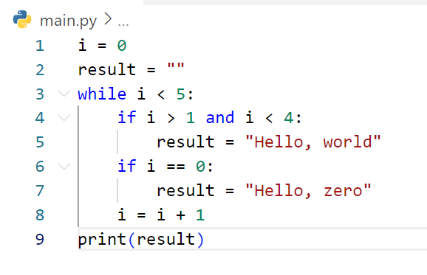
START
DRAW FLOWCHART
i =0
result = “”
no
i<5
yes
no
i<1 and i<4
yes
Result =”Hello, world”
no
I = 0
yes
Result =”Helle, zero”
i = i + 1
Print result
START

Slide 27
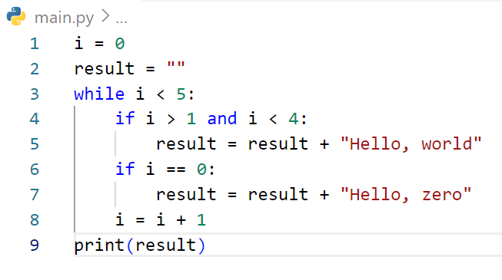
START
DRAW FLOWCHART
i =0
result = “”
no
i<5
yes
no
i<1 and i<4
yes
result =result + ”Hello, world”
no
I = 0
yes
result =result + ”Helle, zero”
i = i + 1
Print result
START

Slide 28
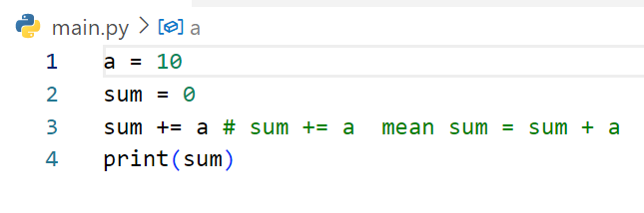
START
DRAW FLOWCHART
a = 10
sum = 0
sum += a
print sum
END

Slide 29
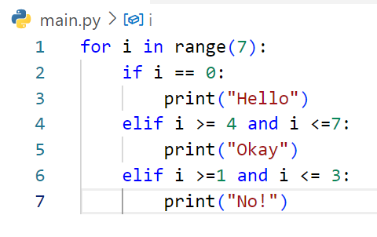
START
DRAW FLOWCHART
done
END
REPEAT 7 TIMES
i == 0
no
yes
i >= 4 and i<=7
no
print “Hello”
yes
i >=1 and i<=3
no
print “Okay”
yes
print “No !”

Slide 30
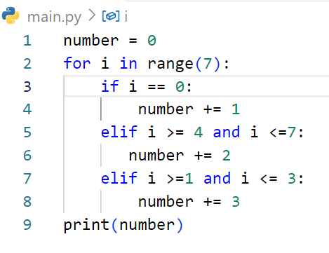
START
DRAW FLOWCHART
number = 0
done
REPEAT 7 TIMES
print number
no
END
i == 0
yes
i >= 4 and i<=7
no
number += 1
yes
no
i >=1 and i<=3
number += 2
yes
number += 3

Slide 31
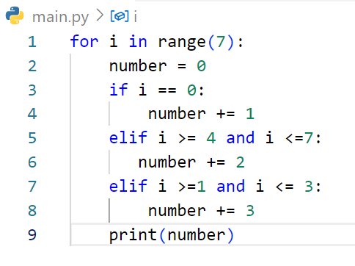
START
DRAW FLOWCHART
done
REPEAT 7 TIMES
END
number = 0
i == 0
no
yes
i >= 4 and i<=7
no
number += 1
yes
no
i >=1 and i<=3
number += 2
yes
number += 3
print number

Slide 32
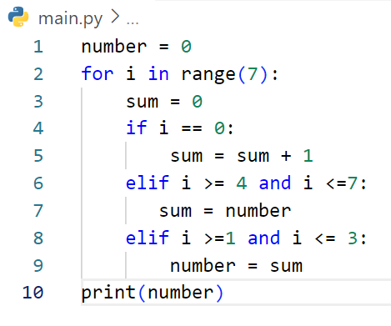
START
DRAW FLOWCHART
number = 0
done
REPEAT 7 TIMES
print number
END
sum = 0
i == 0
no
yes
i >= 4 and i<=7
no
sum = sum + 1
yes
no
i >=1 and i<=3
sum = number
yes
number = sum

Slide 33
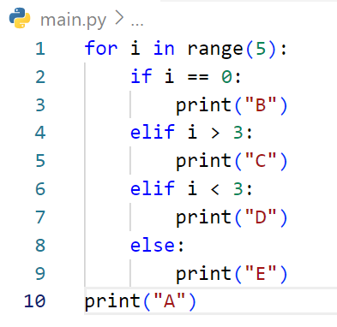
START
DRAW FLOWCHART
done
REPEAT 5 TIMES
print “A”
no
END
i = 0?
yes
i > 3?
no
print “B”
yes
i < 3?
no
print “C”
yes
print “D”
print “E”

Slide 34
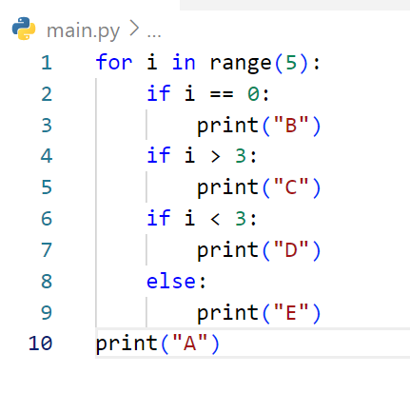
START
DRAW FLOWCHART
done
REPEAT 5 TIMES
print “A”
no
END
i = 0?
yes
i > 3?
no
print “B”
yes
i < 3?
no
print “C”
yes
print “D”
print “E”

Slide 35
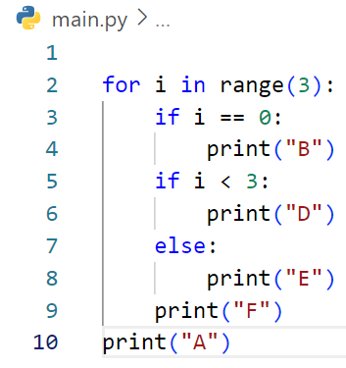
START
DRAW FLOWCHART
done
REPEAT 3 TIMES
print “A”
no
END
i = 0?
yes
i < 3?
no
print “B”
yes
print “D”
print “E”
print “F”

Slide 36
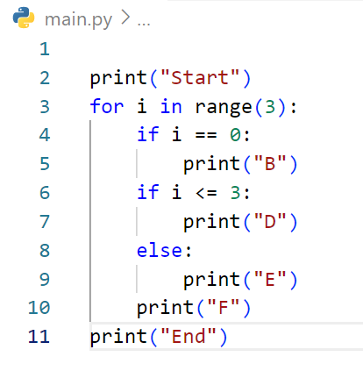
START
DRAW FLOWCHART
print “Start”
done
REPEAT 3 TIMES
print “End”
no
END
i = 0?
yes
i <= 3?
no
print “B”
yes
print “D”
print “E”
print “F”

Slide 37
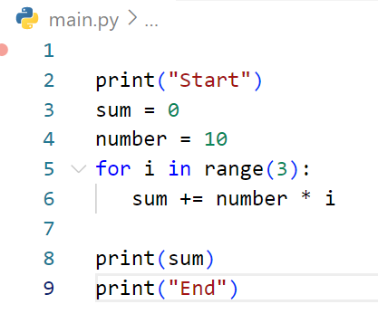
START
DRAW FLOWCHART
print “Start”
sum = 0
number = 10
done
REPEAT 3 TIMES
ongoing
Sum+=number*i
print sum
print “End”
END

Slide 38
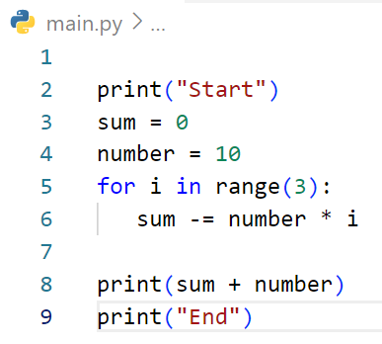
START
print “Start”
DRAW FLOWCHART
sum = 0
number = 10
done
REPEAT 3 TIMES
ongoing
Sum-=number*i
print sum+number
print “End”
END

Slide 39
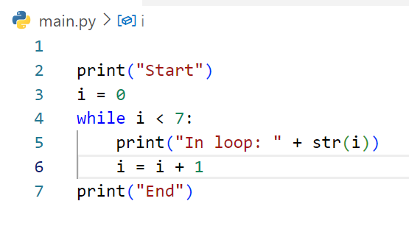
START
DRAW FLOWCHART
print “Start”
i = 0
no
i < 7?
yes
print “In loop: ”+ str(i)
ongoing
i = i + 1
print “End”
END

Slide 40
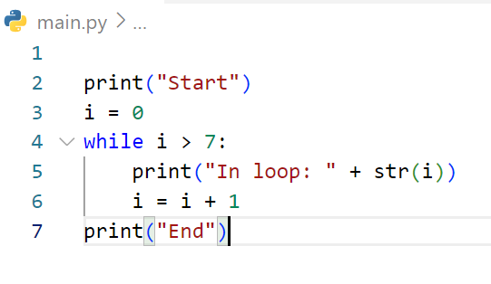
START
DRAW FLOWCHART
print “Start”
i = 0
done
i > 7?
yes
print “In loop: ”+ str(i)
ongoing
i = i + 1
print “End”
END

Slide 41
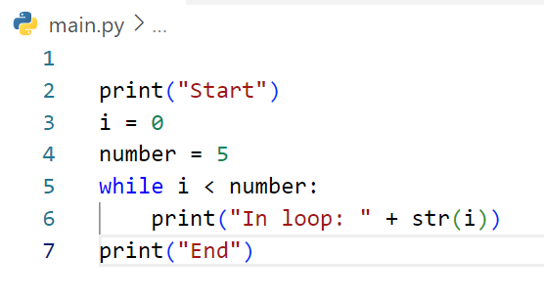
START
DRAW FLOWCHART
print “Start”
i = 0
number=5
no
i < number?
yes
print “In loop: ”+ str(i)
print “End”
END

Slide 42
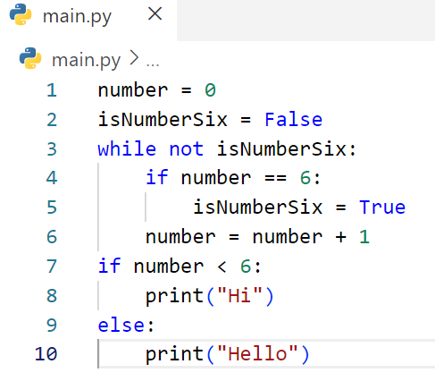
START
DRAW FLOWCHART
number=0
isNumberSix=False
no
not isNumberSix
yes
no
number=6
yes
isNumberSix=True
Number+=1
no
number<6
print “Hello”
yes
print “Hi”
END

